Slide 1

Year 10 Introduction to Explorations
Causes and consequences

Slide 2

Intro to Global Perspectives - Unit Assessment
During this lesson you will be allocated one of the following topic areas and a debatable question that you will research and produce a presentation as a team of 3 or 4
Change in Culture and Communities | EMPLOYMENT | GLOBALISATION | MIGRATION AND URBANISATION
EDUCATION FOR ALL | CLIMATE CHANGE ENERGY AND RESOURCES | LAW AND CRIMINALITY | TRANSPORT, TRAVEL, AND TOURISM
In answering your debatable question you will consider :
Record your notes in your booklet- these will be used to help you assemble your presentation.
Issue global/issue National/Local
Causes and consequences of this issue
Identify and analyse 2 Contrasting Perspectives about this issue
Complete a Source evaluation for at least 2 sources
Evaluate Courses of action for this issue

Slide 3
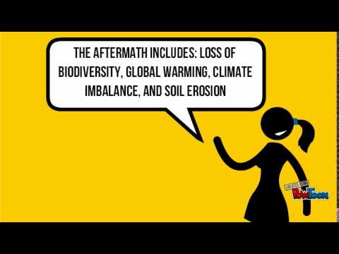
Cause and consequence review
Cause: reason, event that brings about a subsequent outcome (usually referred to as the effect or consequence). Why something is/was done.
Consequence: a result of something that has happened, something as an effect, result, or outcome
Topic: Deforestation
Causes: Logging, clearing land for mineral access and mining, agriculture, urbanization,
Consequences: Loss of biodiversity, global warming and carbon release, climate imbalance, soil erosion,
Global competency skill development: Critical thinking - I am skilled at making connections and seeing relationships

Slide 4
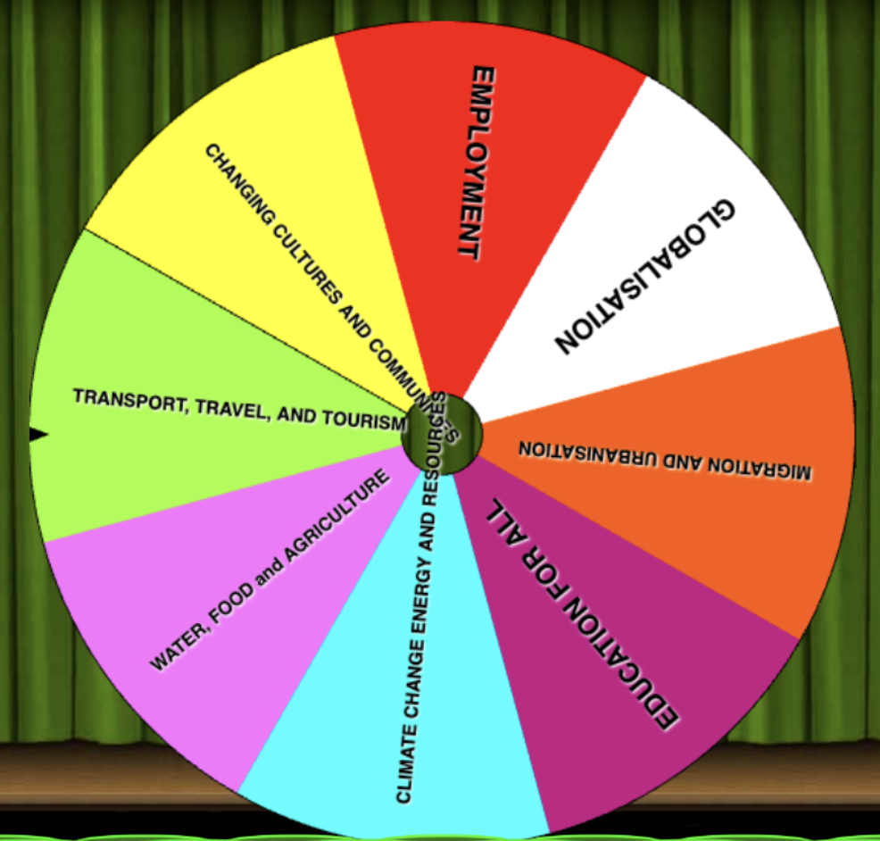
Teams and topics
Allocation of teams of 3/4- each team will be allocated a topic/ debatable question. All topics should be covered- ONLY ONE GROUP PER TOPIC.
Random topic picker
(Teachers, please take out ‘water, food and agriculture’ and replace with law and criminality)

Slide 5
Unit 1-Unit Assessment- Debatable questions
CHANGE IN CULTURE AND COMMUNITIES - This House believes that race and ethnicity, not merit, determine career success.
EMPLOYMENT - This House believes machines taking over jobs does more harm than good in poorer countries.
GLOBALISATION- This House believes that globalisation is destroying unique local cultures.
MIGRATION AND URBANISATION - This House believes that host nations should view mass migration as a threat, not an opportunity.
EDUCATION FOR ALL - This House believes that educating women is the single most important factor in a nation's development.
CLIMATE CHANGE ENERGY AND RESOURCES - This House believes that the environmental cost of transitioning to renewable energy is too high.
Law and criminality -This House believes that punishing criminals is more important than rehabilitating them.
TRANSPORT, TRAVEL, AND TOURISM - This House believes that we should never trust AI to drive our vehicles.

Slide 6
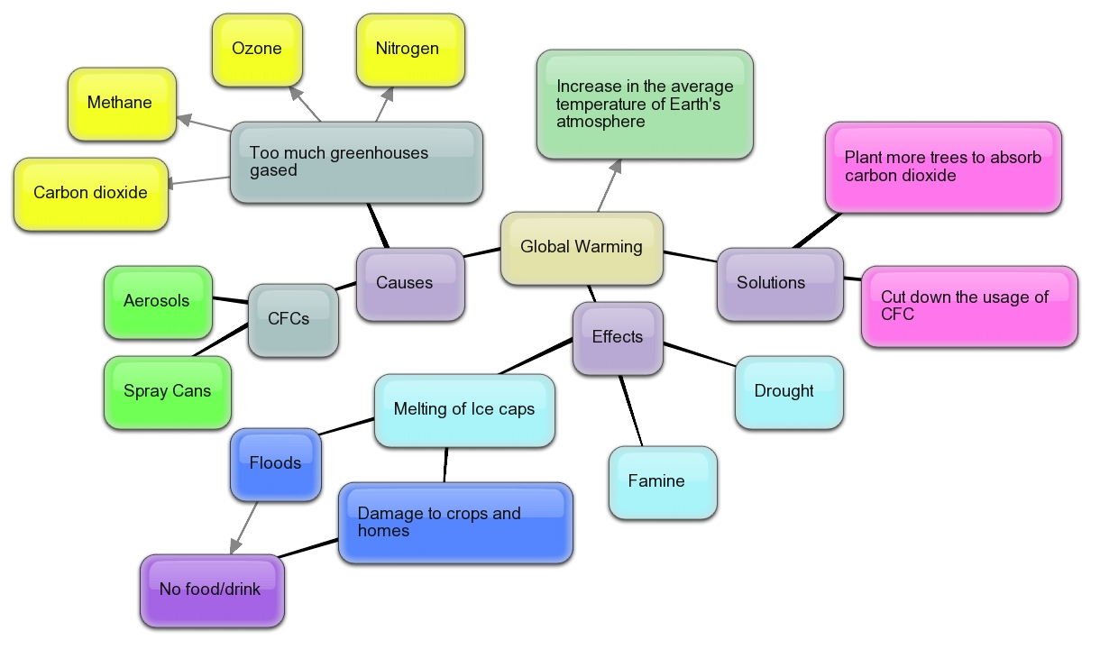
Cause and consequence mapping
Use a large piece of paper to create a collaborative mind map to identify a range of specific causes and consequences for your issue at the global and national scale- what do you already know about your debatable question?
Take a photo or screenshot and put this in your booklet
Global competency skill development: Critical thinking - I am skilled at making connections and seeing relationships

Slide 7

Cause and consequences
What are the causes and consequences of your chosen issue?
Local/National - is this a problem within a city or country?
Global - does this problem show itself at the global level eg - does the UN or other global organization have a global view on this issue?
Find specific evidence through the resources on the next slide and your own research.
Record your ideas in your booklet.
One cause of this problem is…..
Another cause of this is….
One consequence of this issue is…. this is seen in…..

Slide 8
Some resources to get you started!
CHANGING CULTURES AND COMMUNITIES | EMPLOYMENT | GLOBALISATION | MIGRATION AND URBANISATION
Video Article Article Article Article | Video Article Article Article Article | Video Article Article article | Video Article Article Article
EDUCATION FOR ALL | CLIMATE CHANGE ENERGY AND RESOURCES | LAW AND CRIMINALITY | TRANSPORT, TRAVEL, AND TOURISM
Video Article Article Article | Video Article Article Article | Video Video Article Article Article | Video Video Article Article Article Article
You should also conduct some of your own independent research

Slide 9
What evidence should I use to support my argument
Numbers | E.g. date and time, or any specific number or measurement.
Statistics | Although technically just one form of number evidence, statistics are special enough to count as their own separate type of evidence, especially because they are so valuable at making evidence representative.
Names | E.g. place names, names of individuals, organizations, movements, etc.
Expert Opinion | Refers to the use of someone else’s knowledge or opinion, when the author quotes or mentions a recognized expert in the field, could be given as a direct quote
Documentary evidence | E.g. Laws, government policies, speeches, interviews, etc.

Slide 10

Cause and consequence- significance
Significance of Causes and Consequences and how to write about it
It is important to use the language of significance when explaining how important something is. Here is the criteria:
IMPORTANT: People at the time thought it was important.
PEOPLE: It affected a lot of people.
EVENTS: It led to other important events.
ATTITUDES: It changed people's attitudes or the way they lived.
TIME: It affected people for a long time.
Here is a link to language structures that can be used to help you write about significance of your causes and consequences.
Record your significance paragraph in your journal.

